Slide 1

HAND GESTURE RECOGNITION SYSTEM USING IOT
By Team- BOT SQUAD
Hackathon
Organised by- Delhi Hacks
Theme- Social Good

Slide 2



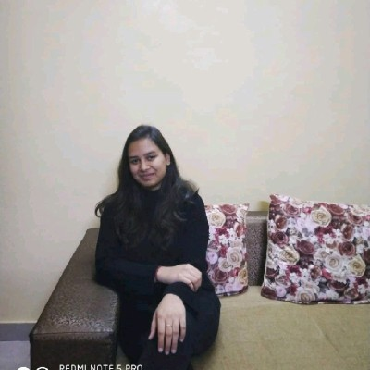
TEAM BOT SQUAD -
DIVYA MAHESHWARI
KARTIK AGARWAL
(Team Leader)
VARNIT GOSWAMI
SHIVANI

Slide 3

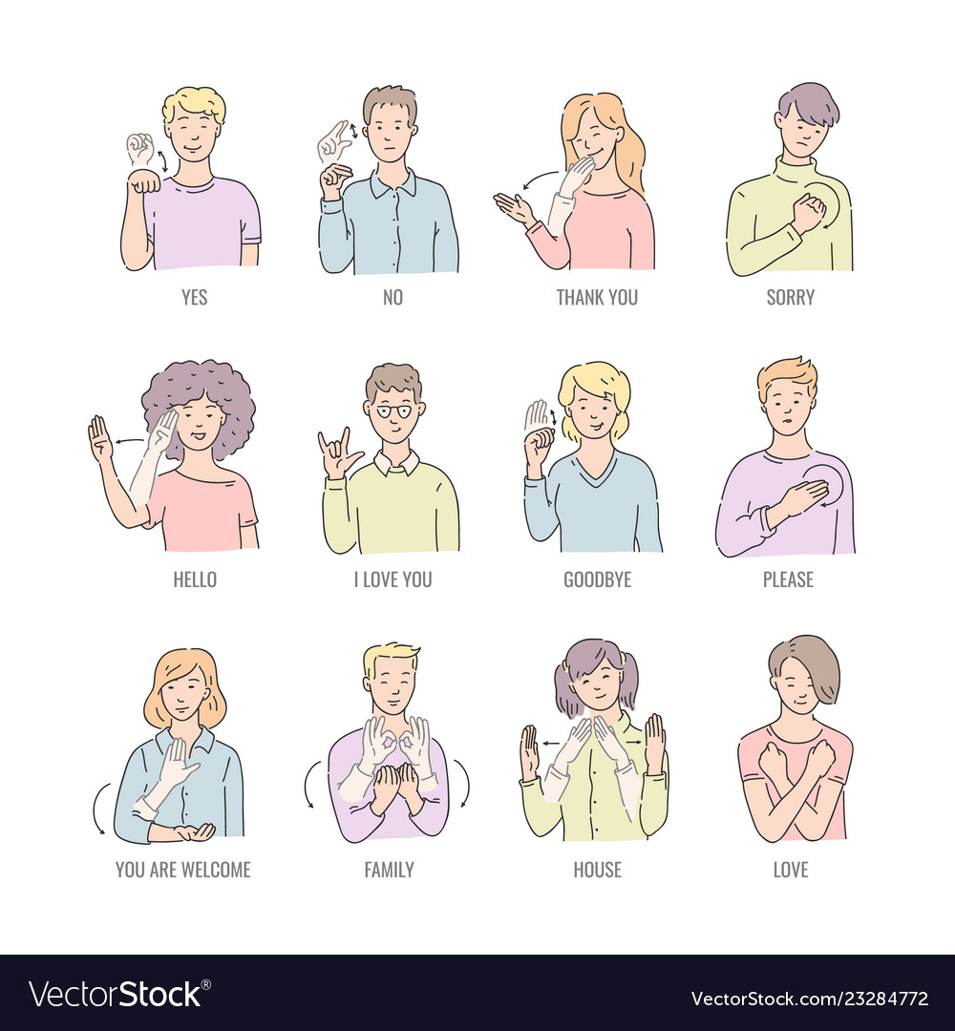
Problem statement
It is difficult for normal people to understand the sign language used by speech impaired people. There is always a communication gap between them.
It makes them feel separated and different and make it difficult to express their thoughts.
What we can do to understand their thoughts and communicate with them in clearly?

Slide 4
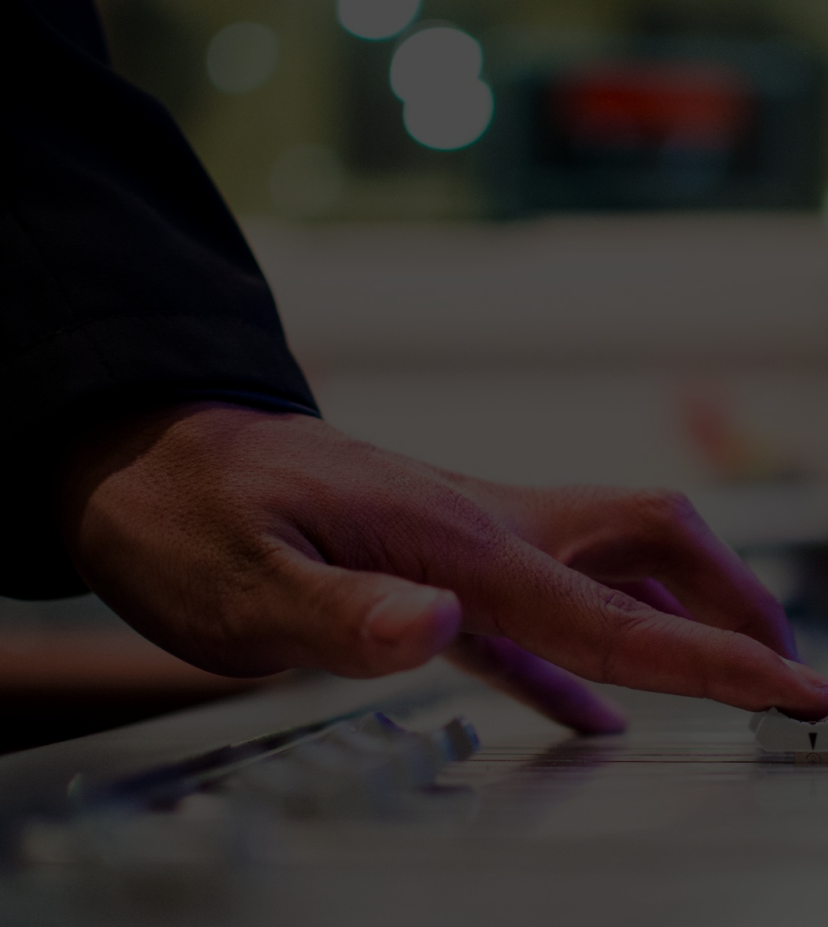
OUR IDEA
Team ‘THE BOT SQUAD’ has come up with the idea of developing a SPEECH AND TEXT SYSTEM USING HAND GESTURE for speech impaired people. This gadget enables them to communicate among themselves, with visually impaired people as well as other normal people.

Slide 5
Features
Features
This uses INTERNET OF THINGS to sense the movement of the person’s fingers to tell others what the person is trying to say through their sign language.
It will help the society by bridging the communication gap between speech/visual impaired people and physically healthy person.
It is a cost effective device which most of the people can afford.

Slide 6
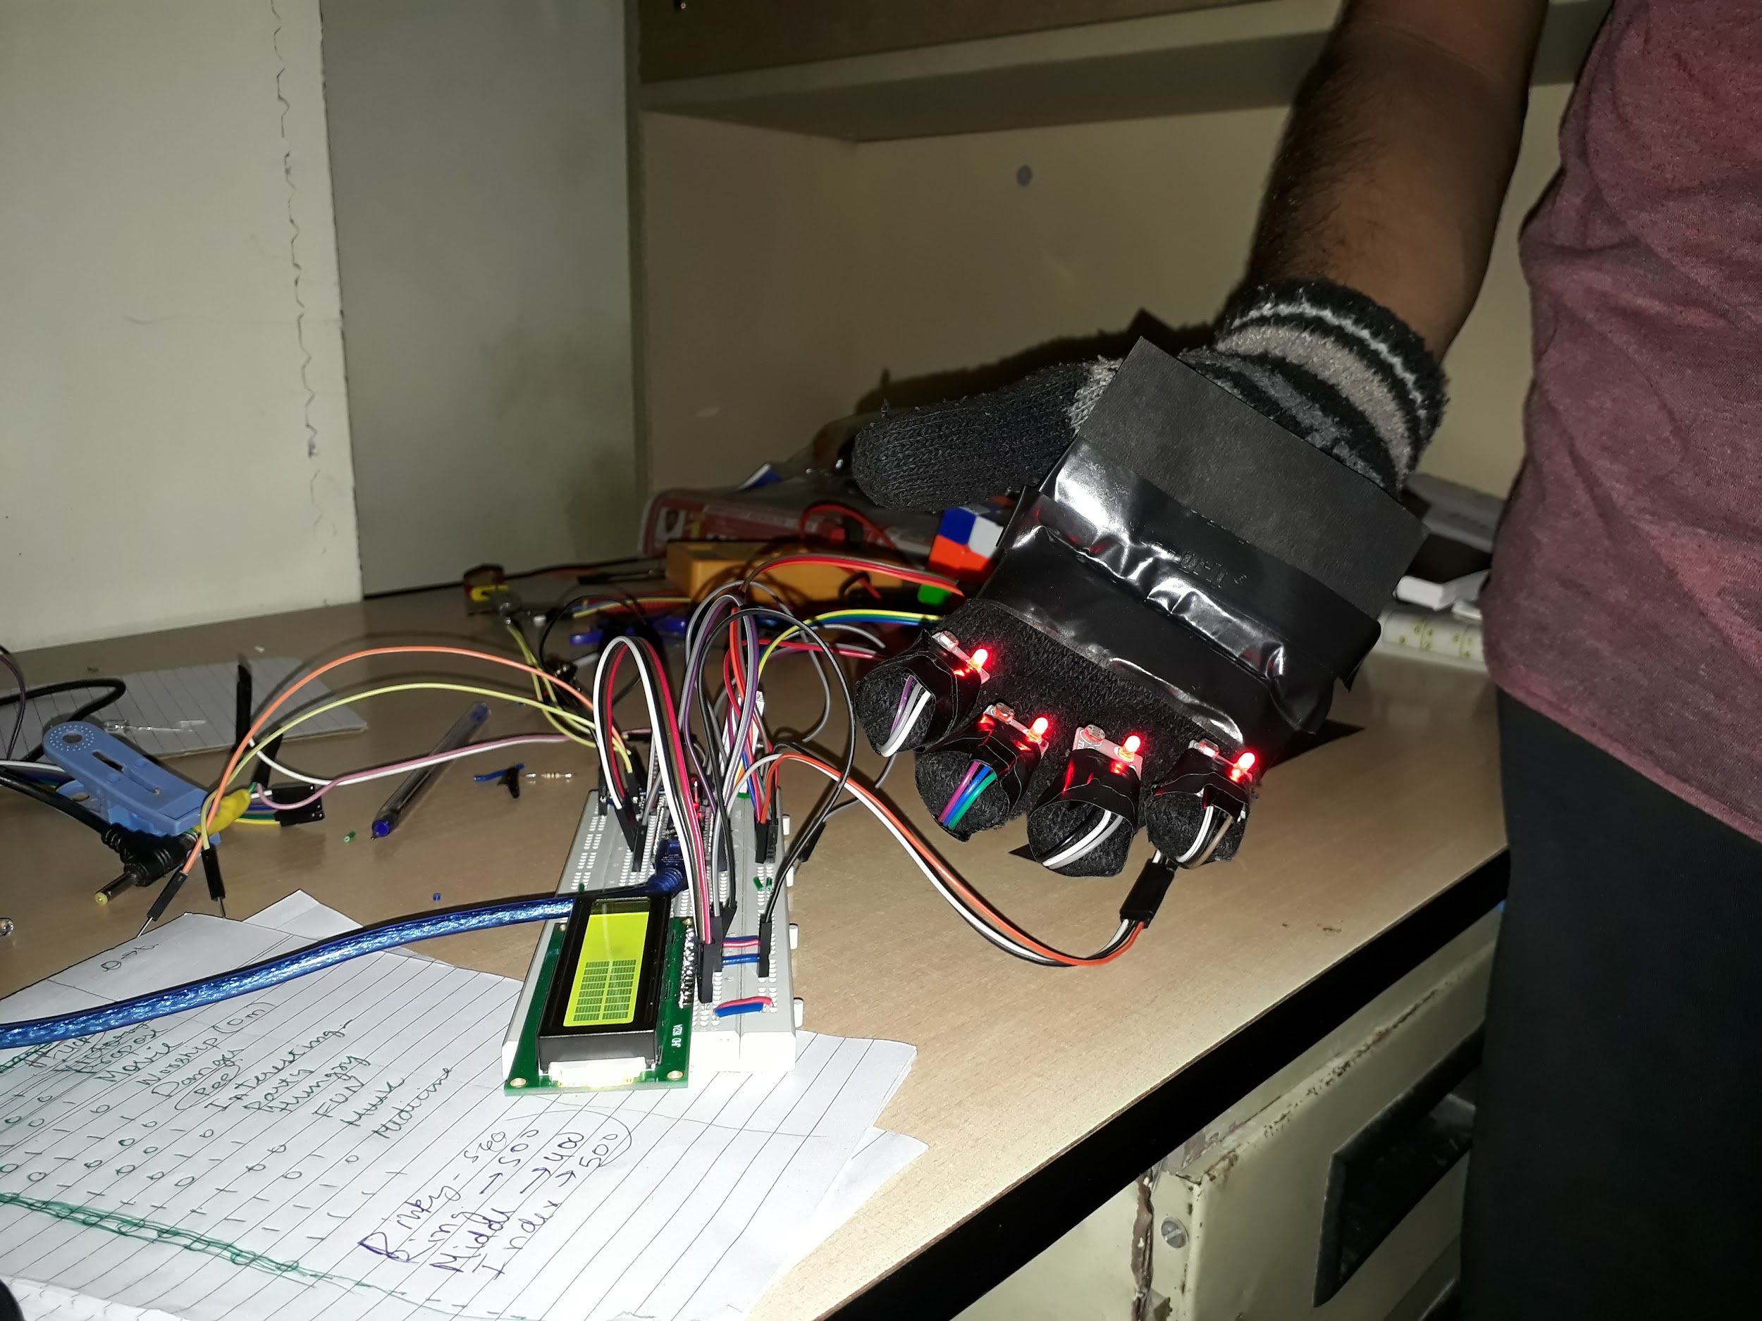
Hardware
The Hardware part includes Arduino programming and the Hand Gesture Recognition setup
Arduino Nano with cable
Four LDR module
16×2 LCD display
IC 7805, 7809
Diode 1n4007
Heat sink
12v battery/adaptor
Some breadboard and jumper wires
Bluetooth HC-05 (for transfer data to our mobile app)

Slide 7

Our Aim-
In this project, we converted gesture pattern into text to Speech.
Then, Text to Speech with bluetooth connection and Speech to Text were implemented with our skills.

Slide 8
How it is made/System Architecture:
The system makes use of a fingers motion reading system equipped with LDR sensors along with a Bluetooth module (HC-05) which can transmit data to the mobile, with the help of app it is spoken out and display on screen simultaneously. This system is powered by a battery powered circuitry to run it. Arduino is used for processing the data and operating the system.
The system consists of around 16 stored messages like “ Help”, “Danger”, “Hungry” and so on that help people to convey basic messages.
The system reads person fingers motions for different variations of hand movement. The Arduino constantly receives input sensor values and then processes it. Now it searches for matching messages for the set of sensor values with a specific pattern. Once it is found in memory the message is retrieved and is spoken out using mobile app. Thus we have a fully functional smart speaking system to help mute people communicate with regular people using a simple wearable system.

Slide 9
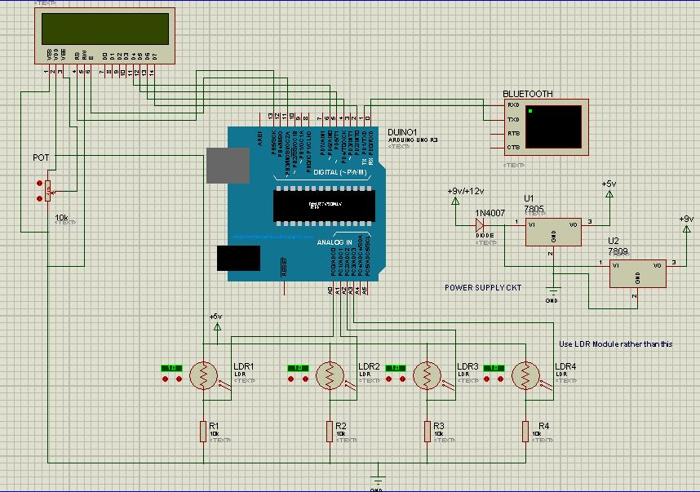
Connection Diagram

Slide 10
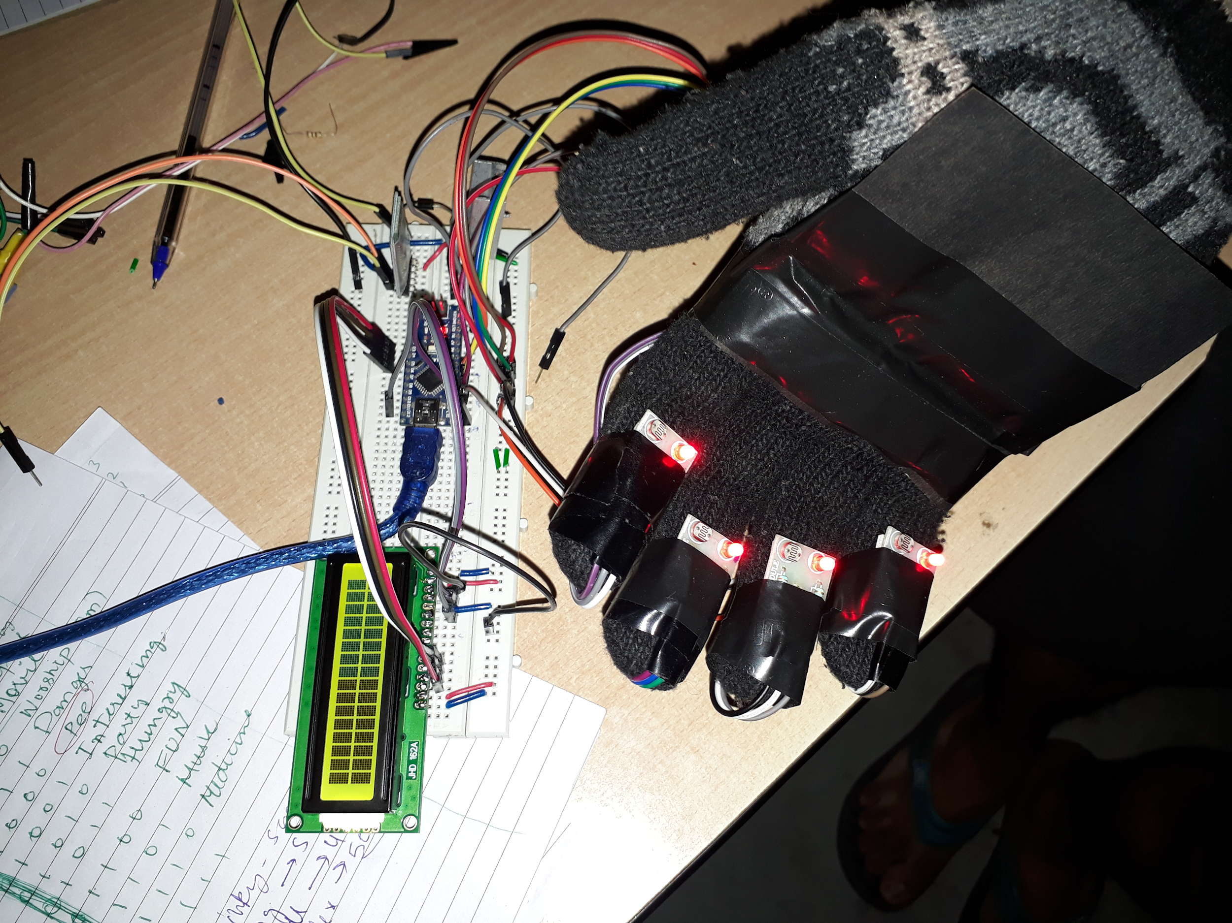
Our Product/Accomplishment
This is how our model looks like and what we have accomplished as a working model.

Slide 11
Milstone
Finding and collecting Hardware parts
Coding in the background
Putting all the hardware together and connecting them to make a working model
Putting all the components together and testing the model

Slide 12
Future Scope
We can introduce some sensors with the help of Gyrometer sensor in hand gesture, we can increase the limits of signs available for different sentences instead of only common words. In terms of marketing the product, we would like to initially target differently abled people centre of our region.
The application can be integrated with other mobile and IoT devices to improve user interaction and make the system more robust.
The accuracy of the program can be further improvised by using neural networks.
Use of the application in the fields of medicines, governance etc. The whole point of making the solution as a commercially viable product for the users is to help the impaired community around the world.

Slide 13
What we learned?
This proved to be a great opportunity for us!
We Learned that without having much components, how to make an efficient project using hardware in specific time and also, learned about the new sensors. Moreover, built a more functioning mobile app.

Slide 14


